Slide 1
Chapt 1 The Machine Learning Landscape

Slide 2
Chapter 구성
First,
Machine Learning 의 종류
Supervised/Unsupervised/Reinforced Learning
Batch and Online Learning
Instance-Based Versus Model-Based Learning
Second,
Insufficient Quantity of Training Data
Nonrepresentative Training Data
Poor-Quality Data
Irrelevant Features
Overfitting the Training Data
Underfitting the Training Data
Third,
Testing and Validating

Slide 3
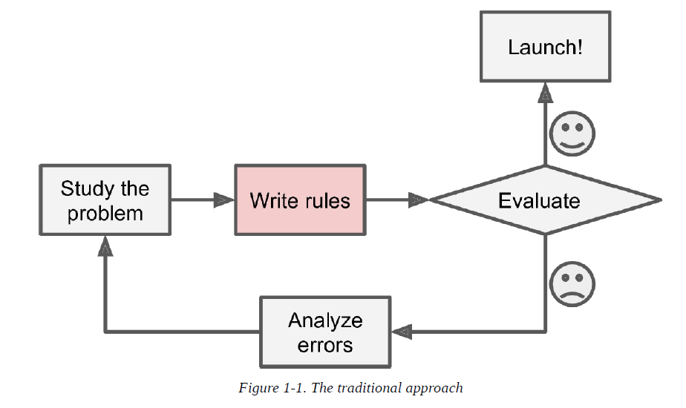
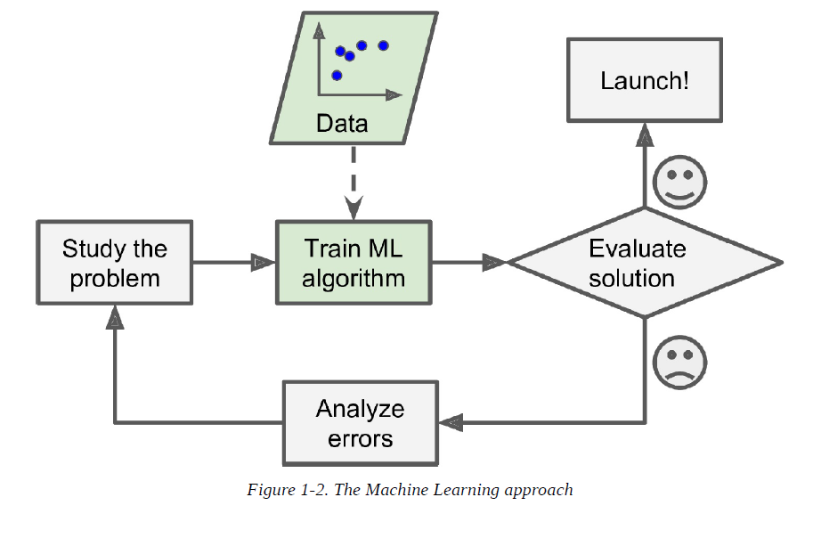
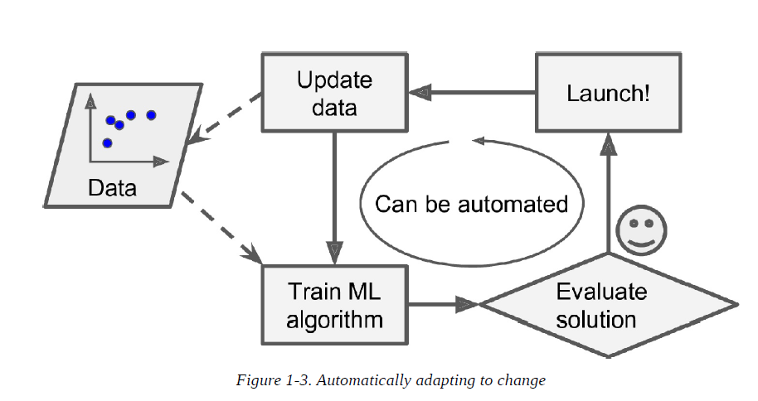
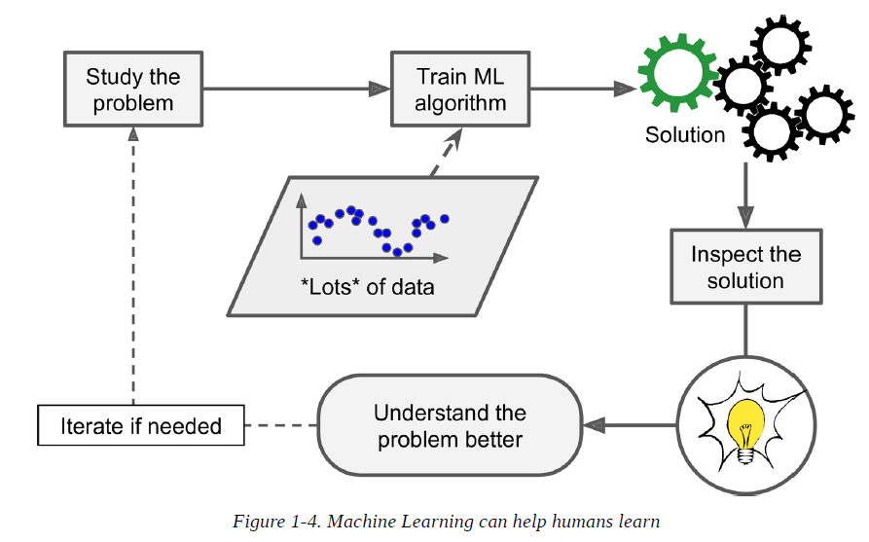
The Machine Learning Landscape
Machine Learning 을 쓰는 이유

Slide 4
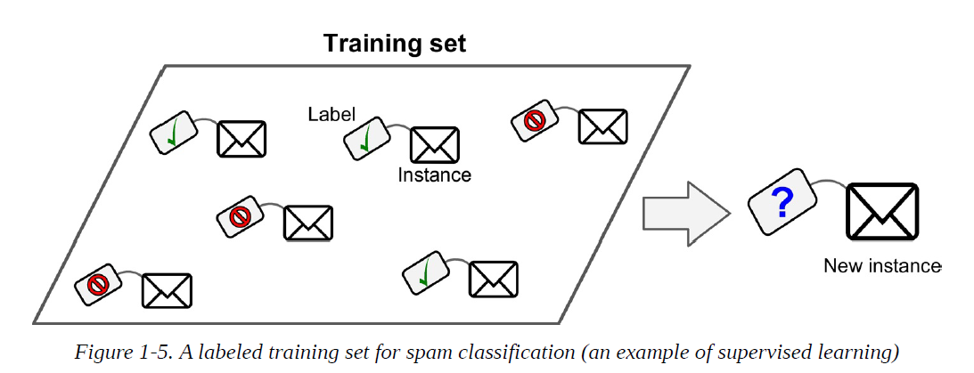
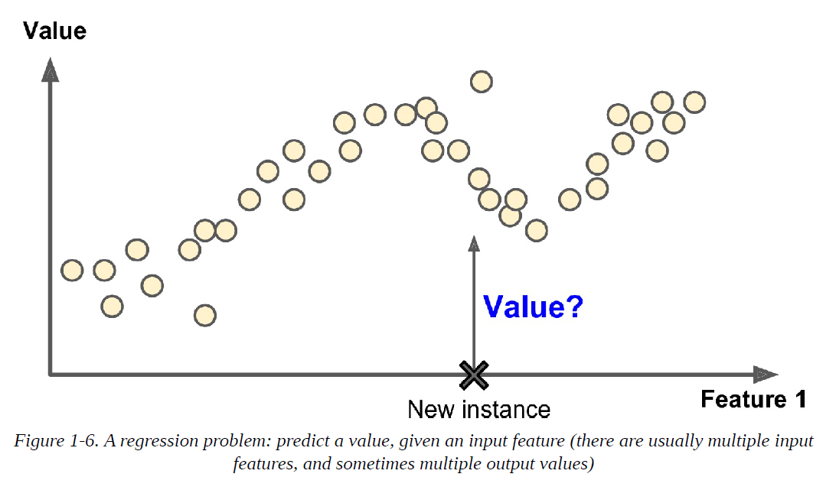
Types of Machine Learning Systems
Supervised Learning: Classification, Regression

Slide 5
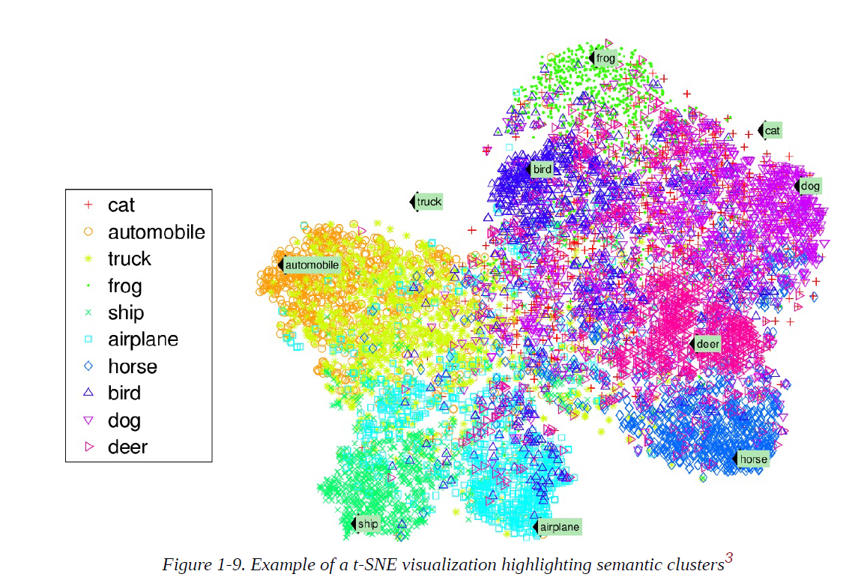
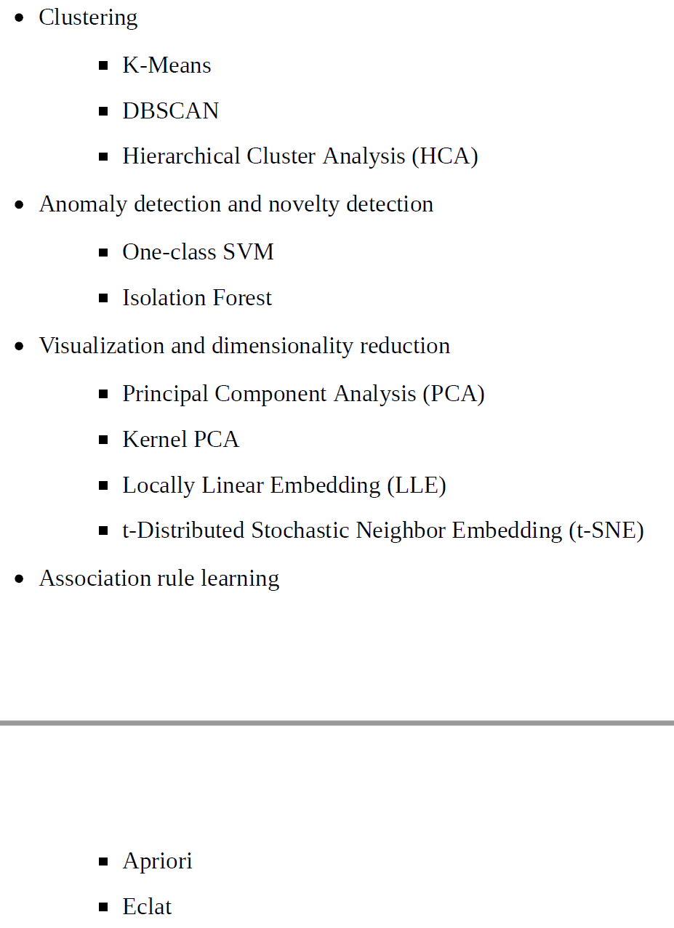
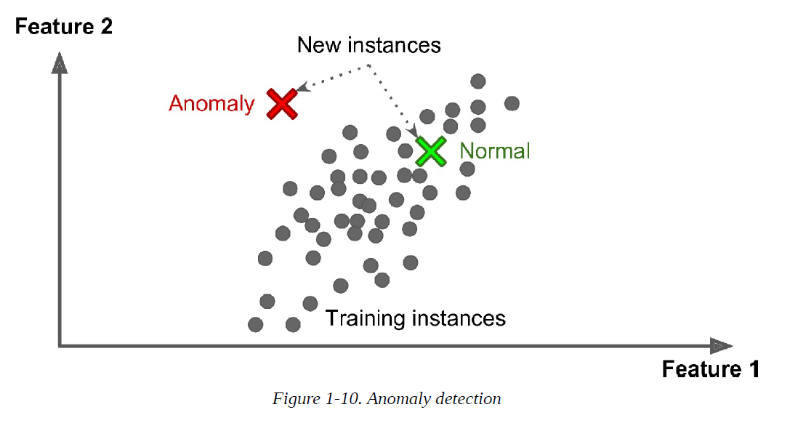
Types of Machine Learning Systems
Unsupervised Learning

Slide 6
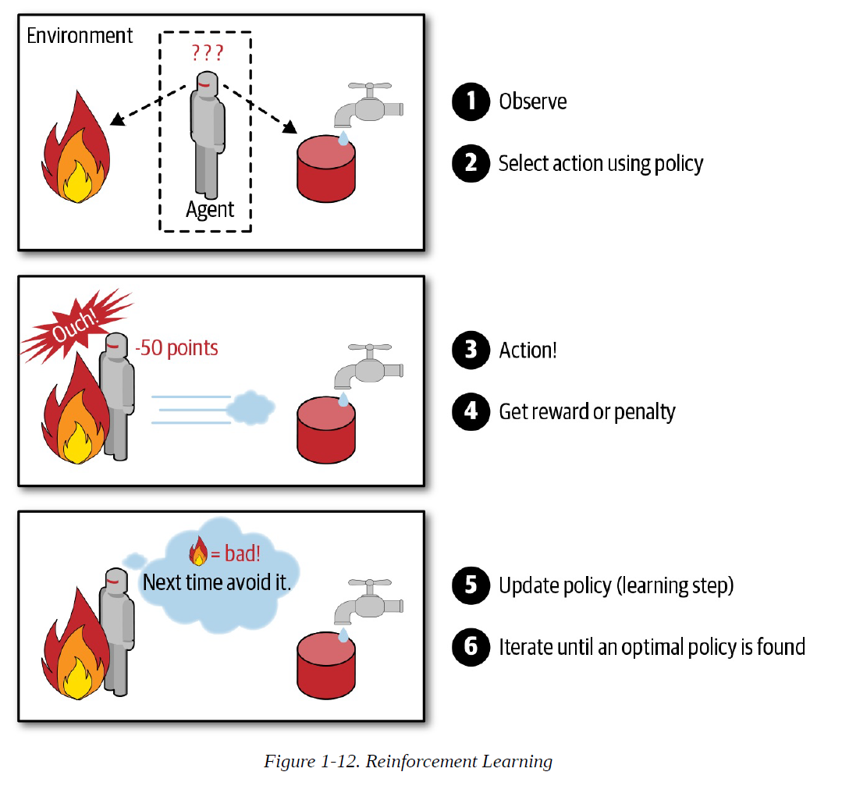
Types of Machine Learning Systems
Reinforced Learning

Slide 7
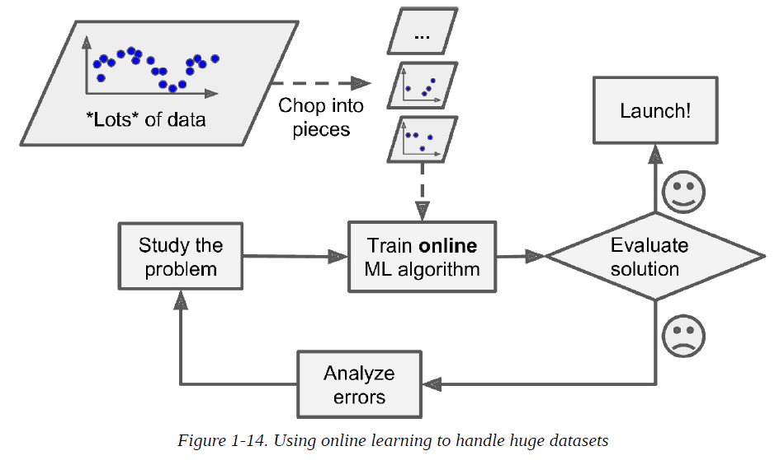
Types of Machine Learning Systems
Batch Learning (Offline Learning)
- Incapable of learning incrementally: must be trained using all the available data
First trained, it runs without learning any more
- To apply new version, stop the old system and replace it with new one
Pros) Simple, often works fine
Cons) Training using the full set of data can take many hrs > train new system only every 24 hrs or weekly
Online Learning

Slide 8
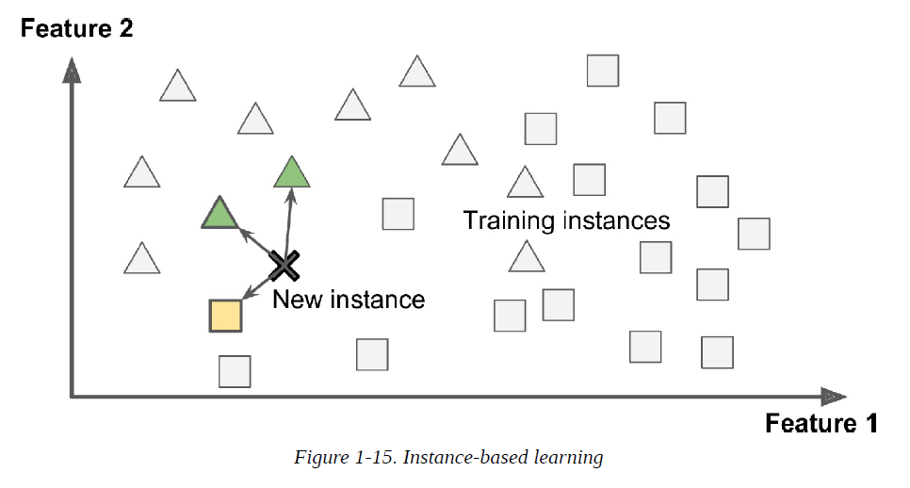
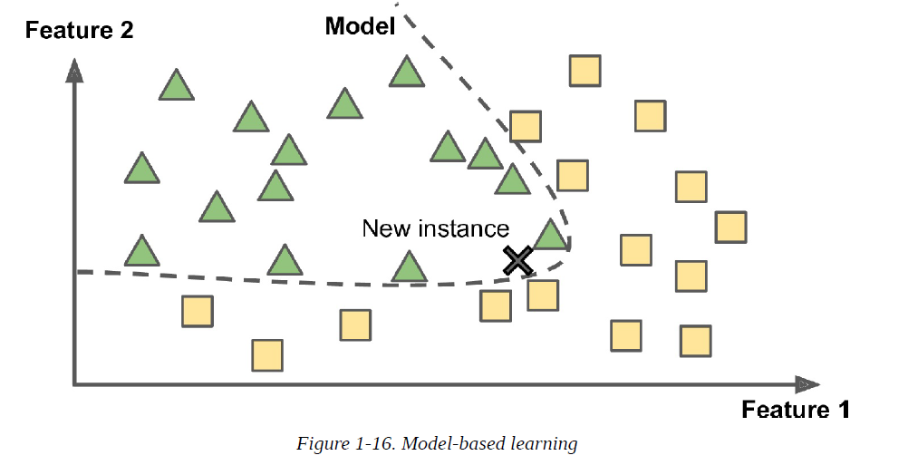
Types of Machine Learning Systems
Instance Based Learning
Model Based Learning

Slide 9
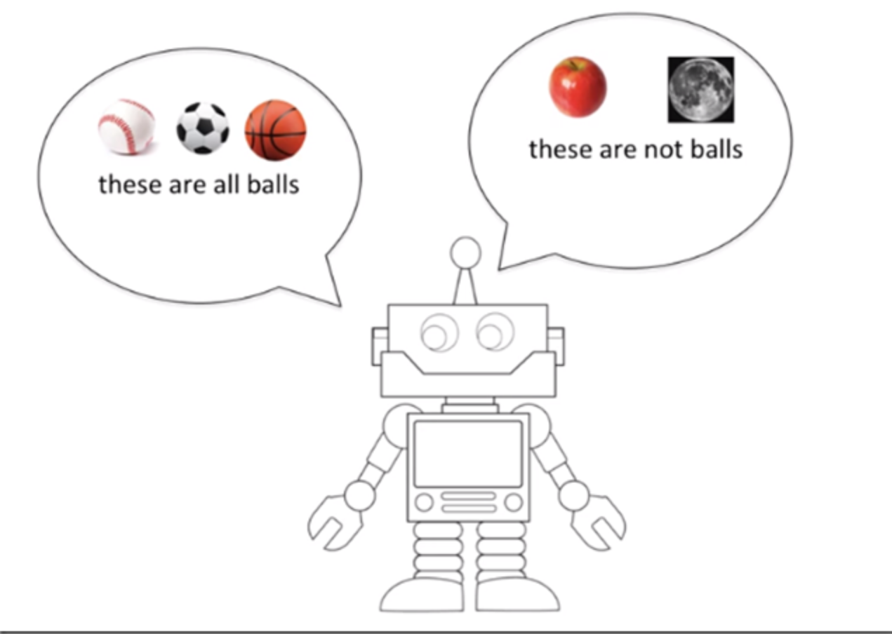

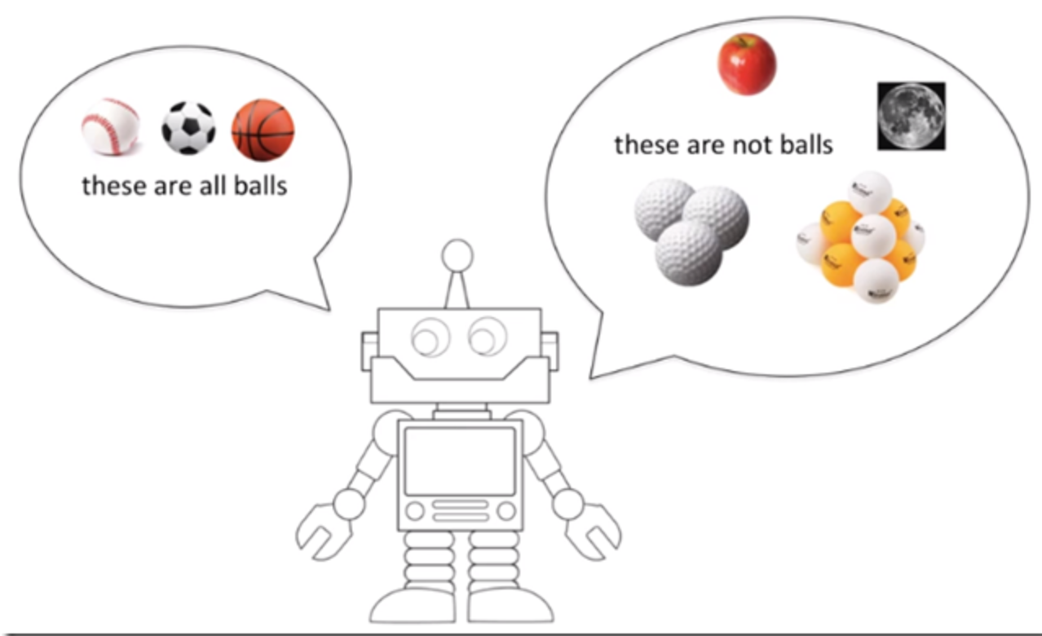
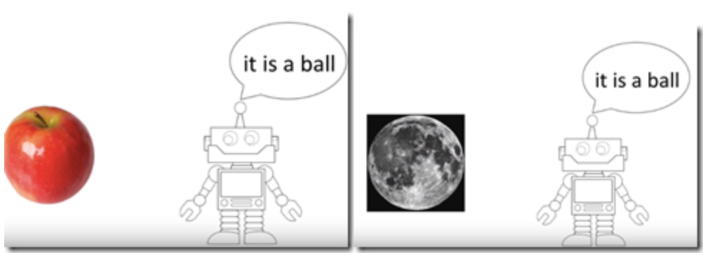
Overfitting the training Data

